Slide 1
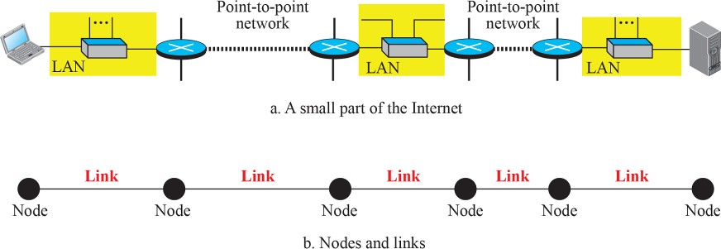
Nodes and Links
Although communication at the application, transport, and network layers is end-to-end, communication at the data-link layer is node-to node.
As we have learned in the previous chapters, a data unit from one point in the Internet needs to pass through many networks (LANs and WANs) to reach another point.
Theses LANs and WANs are connected by routers. It is customary to refer to the two end hosts and the routers as nodes and the networks in between as links.

Slide 2
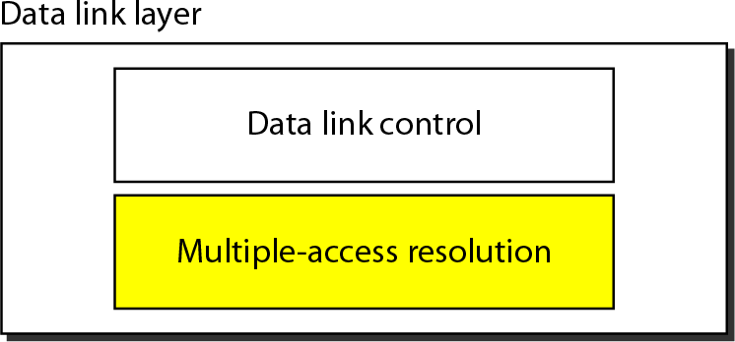
Data Link Layer
Responsible for error and flow control
Link Layer Control (LLC)
control
MAC
Responsible for framing, MAC address and Multiple Access Control
Two functionality-oriented sublayers in DATA LINK LAYER

Slide 3
THE MEDIUM ACCESS CONTROL SUBLAYER
In the OSI protocol stack, channel allocation is addressed in the Medium access control (MAC) sublayer. This is a sublayer of the Data Link Layer - considered to be below the Logical Link Control (LLC) sub-layer.
MAC layer provides an unreliable connectionless service; if required, the LLC layer can convert this into a reliable service by using an ARQ (Automatic repeat request) protocol.
The protocols used to determine who goes next on a multiaccess channel belong to a sublayer of the data link layer called the MAC (Medium Access Control) sublayer.
The MAC sublayer is especially important in LANs,
particularly wireless ones because wireless is naturally a broadcast channel.

Slide 4
THE CHANNEL ALLOCATION PROBLEM:
Links are classified as either broadcast or point-to-point.
With a broadcast link, more than two users share the same transmission media. At times an entire network, in particular a LAN, will consist of a single broadcast link connecting a group of users 1. In this case we refer to the network itself as a broadcast network.
A broadcast link is also called a multiaccess channel. In such a channel,
1. A transmitter can be heard by multiple receivers
2. A receiver can hear multiple transmitters.

Slide 5
In any broadcast network, the key issue is how to determine who gets to use the channel when there is competition for it. To make this point, consider a conference call in which six people, on six different telephones, are all connected so that each one can hear and talk to all the others. It is very likely that when one of them stops speaking, two or more will start talking at once, leading to chaos.
In a face-to-face meeting, chaos is avoided by external means. For example, at a meeting, people raise their hands to request permission to speak. When only a single channel is available, it is much harder to determine who should go next.

Slide 6
How to share a common medium among the many users? how to allocate a single broadcast channel among competing users. The channel might be a portion of the wireless spectrum in a geographic region, or a single wire or optical fiber to which multiple nodes are connected.
In both cases, the channel connects each user to all other users and any user who makes full use of the channel interferes with other users who also wish to use the channel.
When two or more nodes transmit at the same time, their frames will collide and the link bandwidth is wasted during collision.

Slide 7
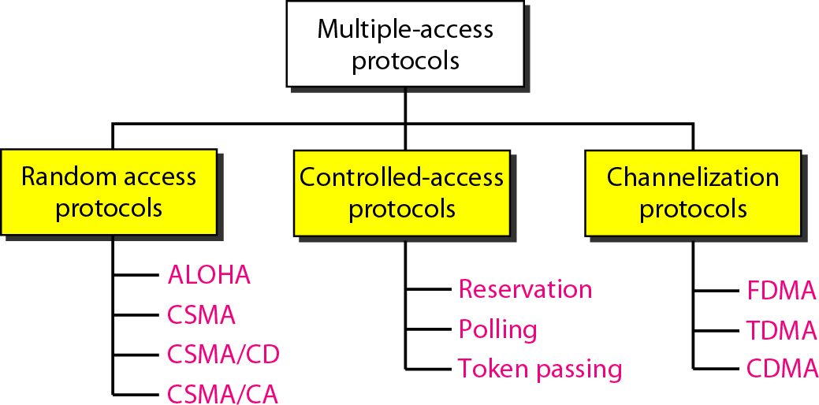
DYNAMIC APPROACH
DYNAMIC APPROACH
STATIC APPROACH

Slide 8
CHANNEL ALLOCATION APPROACHES:
How
to allocate a multiaccess channel among
competing users. In other words, we need a set of
rules (i.e. a protocol) to allow each user to
communicate and avoid interference. There are a
variety of solutions to this problem that are used in practice. These solutions can be classified as either static or dynamic.
With a static approach, the channel's capacity is
essentially divided into fixed portions; each user is
then allocated a portion for all time. If the user has no
traffic to use in its portion, then it goes unused.
With a dynamic approach, the allocation of the channel changes based on the traffic generated by the users. Generally, a static allocation performs better when the traffic is predictable. A dynamic channel allocation tries to get better utilization and lower delay on a channel when the traffic is unpredictable.

Slide 9
STATIC CHANNEL ALLOCATION TECHNIQUES :
Time Division Multiple Access (TDMA) – With TDMA the time axis is divided into time slots of a fixed length. Each user is allocated a fixed set of time slots at which it can transmit. TDMA requires that users be synchronized to a common clock. Typically extra overhead bits are required for synchronization.
Frequency Division Multiple Access (FDMA) – With FDMA the available frequency bandwidth is divided into disjoint frequency bands. A fixed band is allocated to each user. FDMA requires a guard band between user frequency bands to avoid cross-talk.
Another static allocation technique is Code Division Multiple Access (CDMA), this technique is used in many wireless networks

Slide 10
DYNAMIC CHANNEL ALLOCATION TECHNIQUES :
Many different dynamic allocation strategies have been
developed. They can be broadly classified as:
Contention resolution approaches - users transmit a packet when they have data to send- if multiple users transmit at the same time a collision occurs and the packets must be retransmitted according to some rule.
Perfectly scheduled approaches - Users transmit
contention free according to a schedule that is
dynamically formed based on which users have data to send, e.g. polling, reservations. Various combinations of these approaches also exist. We will look at several specific examples in the next few lectures, beginning with a basic contention resolution approach.
As we look at different approaches keep in mind the following two performance criteria:
The delay at low load.
The throughput (channel efficiency) at high load.

Slide 11
Dynamic Channel Allocation in LANs and MANs
Station Model.
Independent stations for generating frames.
Once a frame has been generated, the station is blocked until
the frame has been transmitted.
2.Single Channel Assumption. A single channel for all communication
(send and receive), and all stations are equivalent.
Collision Assumption. If the transmission of two frames overlap in time, a collision occurs. All stations can detect collisions. A collided frame must be retransmitted.
Time assumption.
Continuous Time.
Slotted Time.
Sense assumption.
Carrier sense. Stations can tell if the channel is in use before
trying to use it.
No carrier sense. Stations cannot sense the channel before
trying to use it.

Slide 12
RANDOM ACCESS PROTOCOLS
In random access or contention methods, no station is superior to another station and none is assigned the control over another. No station permits, or does not permit, another station to send. At each instance, a station that has data to send uses a procedure defined by the protocol to make a decision on whether or not to send.
ALOHA ( PURE AND SLOTTED ALOHA )
Carrier Sense Multiple Access (CSMA)
Carrier Sense Multiple Access with Collision Detection (CSMA/CD)
Carrier Sense Multiple Access with Collision Avoidance (CSMA/CA)

Slide 13
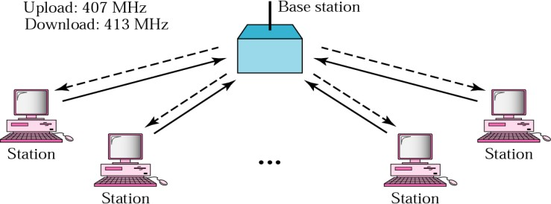
ALOHA Protocol
ALOHA is developed in the 1970s at the University of Hawaii for wireless
LAN and can be used for any shared medium.
It has two variants:
PURE ALOHA
SLOTTED ALOHA
The basic idea is simple:
Let users transmit whenever they have data to be sent.
If two or more users send their frames at the same time, a collision occurs and the frames are destroyed.

Slide 14
Pure ALOHA
How the channel know that there is a collision:
Due to the feedback property of broadcasting, a sender can always find out whether its frame was destroyed by listening to the channel, the same way other users do. With a LAN, the feedback is immediate; with a satellite, there is a delay of 270 msec before the sender knows if the transmission was successful.
If listening while transmitting is not possible for some reason, acknowledgements are needed.

Slide 15
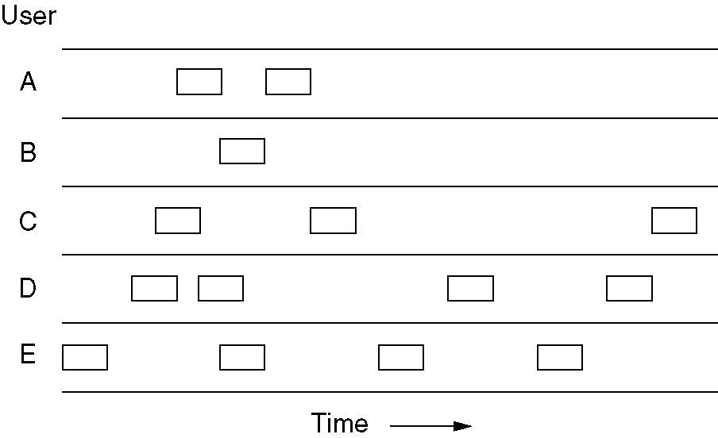
Pure ALOHA
In pure ALOHA, frames are transmitted at completely
arbitrary times.
The throughput of ALOHA systems is maximized by having a uniform frame size rather than by allowing variable length frames.

Slide 16

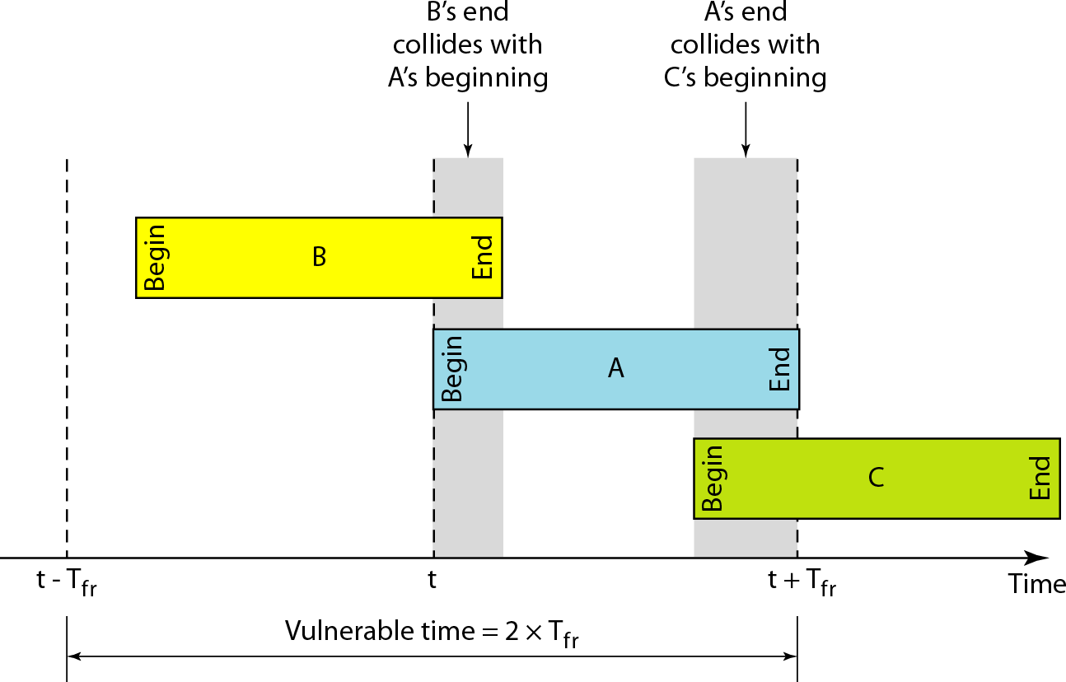

Critical ( Vulnerable ) time for pure ALOHA protocol
Under what conditions will the packet arrive A undamaged?
T_{fr}= Frame Transmission time
If the frame transmission time is T_{fr} sec
then the vulnerable time is = 2 T_{fr} sec
This means no station should send during the T-sec before this station starts transmission and no station should start sending during the T-sec period that the current station is sending.

Slide 17
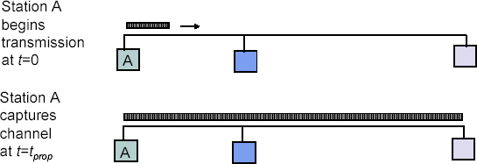

Maximum propagation delay (t_{p}):
The time it takes for a bit of a frame to travel between the
two most widely separated stations.
The farthest
station
Station B receives the first bit of the frame at time t= t_{p}

Slide 18
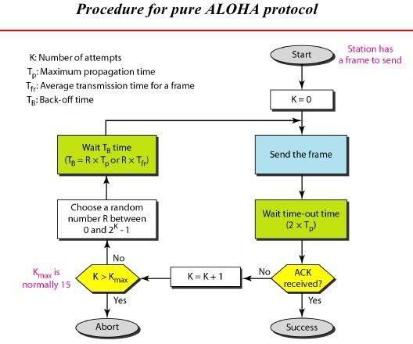

Slide 19


Node 1 Packet
Waiting a random time
Node 2 Packet
Retransmission
Retransmission
1
2 3
Collision
3
2
Time
Node 3 Packet
Collision mechanism in ALOHA

Slide 20
Throughput of Pure ALOHA
Efficiency or Throughput (S) of ALOHA defines average number of frames successfully transmitted per unit time.
The probability that n packets arrive in two packets time is
given by
here –
G is average number of frames generated by the system (all stations) during one frame transmission time
(2G)^{n} e ^{-2G}
n!
P(n)=
The probability P(0) that a packet is successfully received without collision is calculated by letting n=0 in the above
equation. We get
P(0) = e^{−2G}
We can calculate throughput S with a traffic load G as
follows:
S = G ⋅ P(0) = G ⋅ e^{−2G}

Slide 21

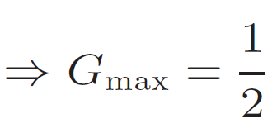
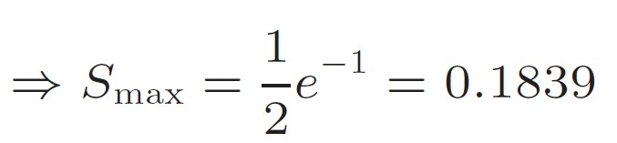
The throughput (S) for pure ALOHA is S = G × e ^{−2G}
The maximum throughput can be obtained by -
G = Average number of frames generated by the system (all stations) during one frame transmission time

Slide 22
Example
The stations on a wireless ALOHA network are a maximum of 600 km apart. If we assume that signals propagate at 3 × 10⁸ m/s, we find
Tp = (600 × 10⁵ ) / (3 × 10⁸ ) = 2 ms.
Now we can find the value of TB for different values of K .
a. For K = 1, the range is {0, 1}. The station needs to| generate a random number with a value of 0 or 1. This means that TB is either 0 ms (0 × 2) or 2 ms (1 × 2), based on the outcome of the random variable.

Slide 23
Example (continued)
b. For K = 2, the range is {0, 1, 2, 3}. This means that TB can be 0, 2, 4, or 6 ms, based on the outcome of the random variable.
c. For K = 3, the range is {0, 1, 2, 3, 4, 5, 6, 7}. This means that TB can be 0, 2, 4, . . . , 14 ms, based on the outcome of the random variable.
d. We need to mention that if K > 10, it is normally set to 10.

Slide 24



Example
A pure ALOHA network transmits 200-bit frames on a shared channel of 200 kbps. What is the requirement to make this frame collision-free?
Solution
Average frame transmission time Tfr is 200 bits/200 kbps or 1 ms.
The vulnerable time is 2 × 1 ms = 2 ms.
This means no station should send later than 1 ms before this station starts transmission and no station should start sending during the one 1-ms period that this station is sending.

Slide 25
Example
A pure ALOHA network transmits 200-bit frames on a shared channel of 200 kbps. What is the throughput if the system (all stations together) produces
a. 1000 frames per second b. 500 frames per second
c. 250 frames per second.
Solution
The frame transmission time T_{fr} = 200 bits/200 kbps or 1 ms.
a. If the system creates 1000 frames per second, this is 1 frame per millisecond. The load G is 1.
In this case -
S = G× e^{−2 G} or S = 0.135 (13.5 percent). This means
that the throughput is 1000 × 0.135 = 135 frames. Only 135 frames out of 1000 will probably survive.

Slide 26
Example (continued)
b. If the system creates 500 frames per second, this is (1/2) frame per millisecond. The load G is (1/2).
In this
case S = G × e ^{−2G} or S = 0.184 (18.4 percent). This means that the throughput is 500 × 0.184 = 92 and that only 92 frames out of 500 will probably survive.
c. If the system creates 250 frames per second, this is(1/4) frame per millisecond.
The load is (1/4). In this case S = G × e −^{2G} or S = 0.152 (15.2 percent). This means that the throughput is 250 × 0.152 = 38.
Only 38 frames out of 250 will probably survive.

Slide 27
Pure Aloha Throughput
0.2
0.18
0.16
0.14
0.12
0.1
0.08
0.06
0.04
0.02
Throughput (S)
0
0
1 2 3 4
Average Number of frames per unit time (G)
5

Slide 28
Slotted ALOHA protocol
The method: Divide time into discrete intervals, each interval corresponding to one frame.
A special station emits a pip at the start of each interval, like a clock.
A user is not permitted to send whenever a special character (for example: CR) is typed. Instead, it is required to wait for the beginning of the next slot.

Slide 29
Slotted ALOHA protocol (contd.)
“Danger / CrEnhancement of pure ALOHA in that stations can only start to transmit frame so that it arrives at the destination at the beginning of defined time slots of duration T
itical / Vulnerable” period for this system is only the T seconds prior to the start of station’s frame and thus S=Ge^{-G}
For this system, optimum throughput occurs if G=1

Slide 30
Slotted ALOHA
Time is divided into slots equal to a frame transmission time (T_{fr})
A station can transmit at the beginning of a slot only
If a station misses the beginning of a slot, it has to wait until the beginning of the next time slot.
A central clock or station informs all stations about the start of a each slot

Slide 31
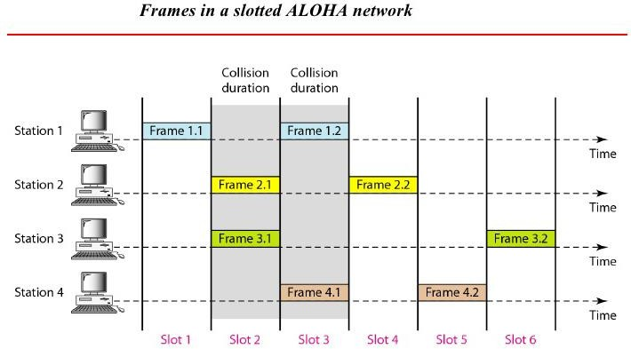

Slide 32
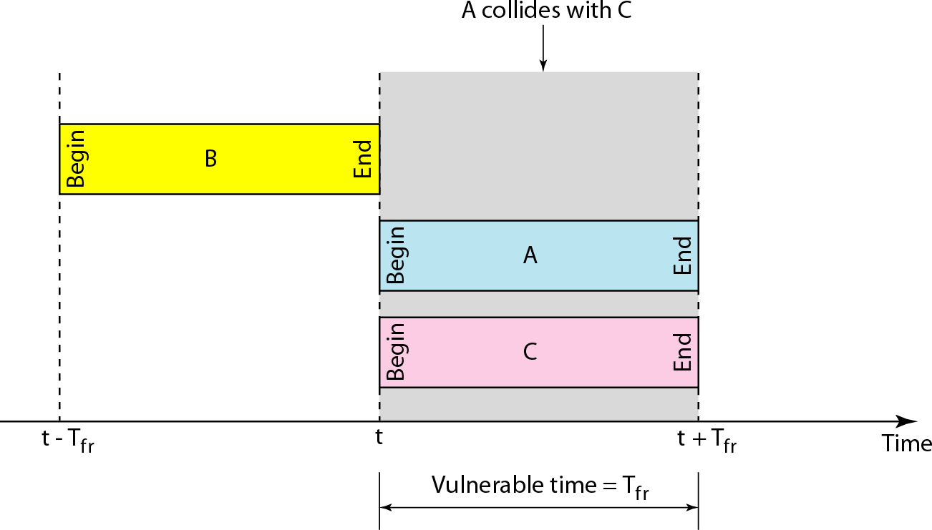
Vulnerable time for slotted ALOHA protocol

Slide 33
Slotted ALOHA
The vulnerable period is now reduced in half.
Probability of no other packet generated during the vulnerable period is:
P = e^{−G}
0
Hence, S = G e^{-G}
Now here S_{max} = 1/e = 0.368 at G = 1
So, Maximum channel utilization is 36.8%

Slide 34
Slotted Aloha Throughput
0.4
0.35
0.3
0.25
0.2
0.15
0.1
0.05
Throughput (S)
0
0
1 2 3 4
Average Number of frames per unit time (G)
5

Slide 35

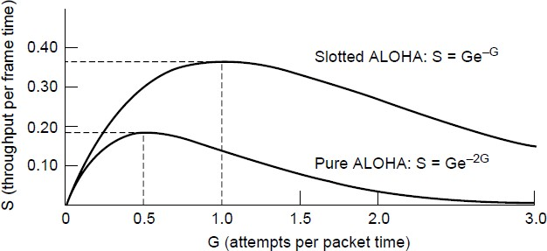
Performance Comparison of ALOHA
Slotted ALOHA can double the throughput
of pure ALOHA
Slotted ALOHA peaks at G = 1, with S = 1/e ≈ 0.368, twice that of pure ALOHA. The main reason for poor channel utilization of ALOHA (pure or slotted) is that all stations can transmit at will, without paying attention to what the other stations are doing.
Throughput versus offered traffic for ALOHA systems

Slide 36
Numericals based on ALOHA

Slide 37
Question
A slotted ALOHA
network transmits 200-bit frames on a shared
channel of 200 kbps.
What is the throughput if the system (all stations together)
b. 500 frames per second
produces
a. 1000 frames per second
c. 250 frames per second.
Solution
The frame transmission time is 200/200 kbps or 1 ms.
a. If the system creates 1000 frames per second, this is 1 frame per millisecond. The load is 1. In this case S = G× e^{−G} or S = 0.368 (36.8 percent). This means that the throughput is 1000 × 0.0368 = 368 frames. Only 386 frames out of 1000 will probably survive.

Slide 38
(continued)
b. If the system creates 500 frames per second, this is (1/2) frame per millisecond. The load is (1/2). In this case S = G × e^{−G} or S = 0.303 (30.3 percent). This means that the throughput is 500 × 0.303 = 151. Only 151 frames out of 500 will probably survive.
c. If the system creates 250 frames per second, this Is (1/4) frame per millisecond. The load is (1/4).
In this case S = G × e ^{−G} or S = 0.195 (19.5 percent). This means that the throughput is 250 × 0.195 = 49. Only 49 frames out of 250 will probably survive.

Slide 39
Consider the delay of pure ALOHA versus slotted ALOHA at low load . Which one is less? Explain your answer.
Solution
At low load, no collisions are likely. In slotted ALOHA we still need to wait for the
next slot beginning time to transmit, so delay is higher.
Ten thousand airline reservation stations are competing for the use of a single slotted ALOHA channel. The average station makes 18 requests/hour. A slot is 125 μ s. What is the approximate total channel load?
Solution
Each terminal makes one request every 200 seconds, for a total load of 50requests/second. This allows us to find the attempt rate, which is the quantity that determines channel load (not just original transmissions but the retransmissions as well).Thus G= 50/8000 = 1/160 is the answer.

Slide 40
Measurements of a slotted ALOHA channel with an infinite number of users
show that 10 percent of the slots are idle.
What is the channel load G ?
(b) What is the throughput?
(c) Is the channel underloaded or overloaded?
Solution
What is the channel load, G?
Ans: When a slot is idle, there is 0 frame generated in that frame time.
Therefore P[succ]=0.1.
P[succ]=e^{-G}=0.1;
-G=ln(0.1); G=2.303.
What is the throughput?
Ans: S=Ge^{-G}=2.303*0.1=0.2303.
Is the channel underloaded or overloaded?
Ans: When G=1, the slotted Aloha obtains the optimal throughput. G>1, we have too many generated frame in a slot. It is a overloaded situation.
Here we have G=2.303; S=0.2303<Smax=0.368. G>S. Therefore the channel is overloaded.

Slide 41
Suppose measurements made on a slotted ALOHA channel for a very large
number of users shows that on average 20% of the slots are idle.
What is the channel load G ?
What is the throughput?
Is the channel underloaded or overloaded?
Solution
What is the channel load, G?
Ans: When a slot is idle, there is 0 frame generated in that frame time.
Therefore P[succ]=0.2.
P[succ]=e^{-G}=0.2;
-G=ln(0.2); G=1.61.
What is the throughput?
Ans: S=Ge^{-G}=1.61*0.2=0.32.
Is the channel underloaded or overloaded?
Ans: Slotted ALOHA is at is optimal (maximum utilization / throughput) at G = 1.0, so this channel is overloaded.
Therefore the channel is overloaded.

Slide 42
CSMA (Carrier-Sense Multiple-Access )
The poor efficiency of the ALOHA scheme can be attributed to the fact that a node start transmission without paying any attention to what others are doing.
In situations where propagation delay of the signal between two nodes is small compared to the transmission time of a packet, all other nodes will know very quickly when a node starts transmission. This observation is the basis of the carrier-sense multiple-access (CSMA) protocol.
In this scheme, a node having data to transmit first listens to the medium to check whether another transmission is in progress or not. The node starts sending only when the channel is free, that is there is no carrier. That is why the scheme is also known as listen-beforetalk.

Slide 43
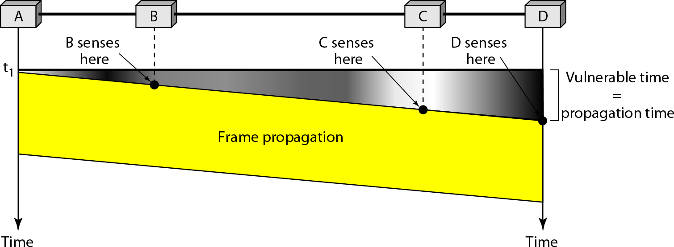
Vulnerable time in CSMA

Slide 44
Behavior of three persistence methods
There are three variations of this basic scheme as outlined below.
1-persistent CSMA: In this case, a node having data to send, start sending, if the channel is sensed free. If the medium is busy, the node continues to monitor until the channel is idle. Then it starts sending data.
Non-persistent CSMA: If the channel is sensed free, the node starts sending the packet. Otherwise, the node waits for a random amount of time and then monitors the channel.
p-persistent CSMA: If the channel is free, a node starts sending the packet. Otherwise the node continues to monitor until the channel is free and then it sends with probability p.

Slide 45
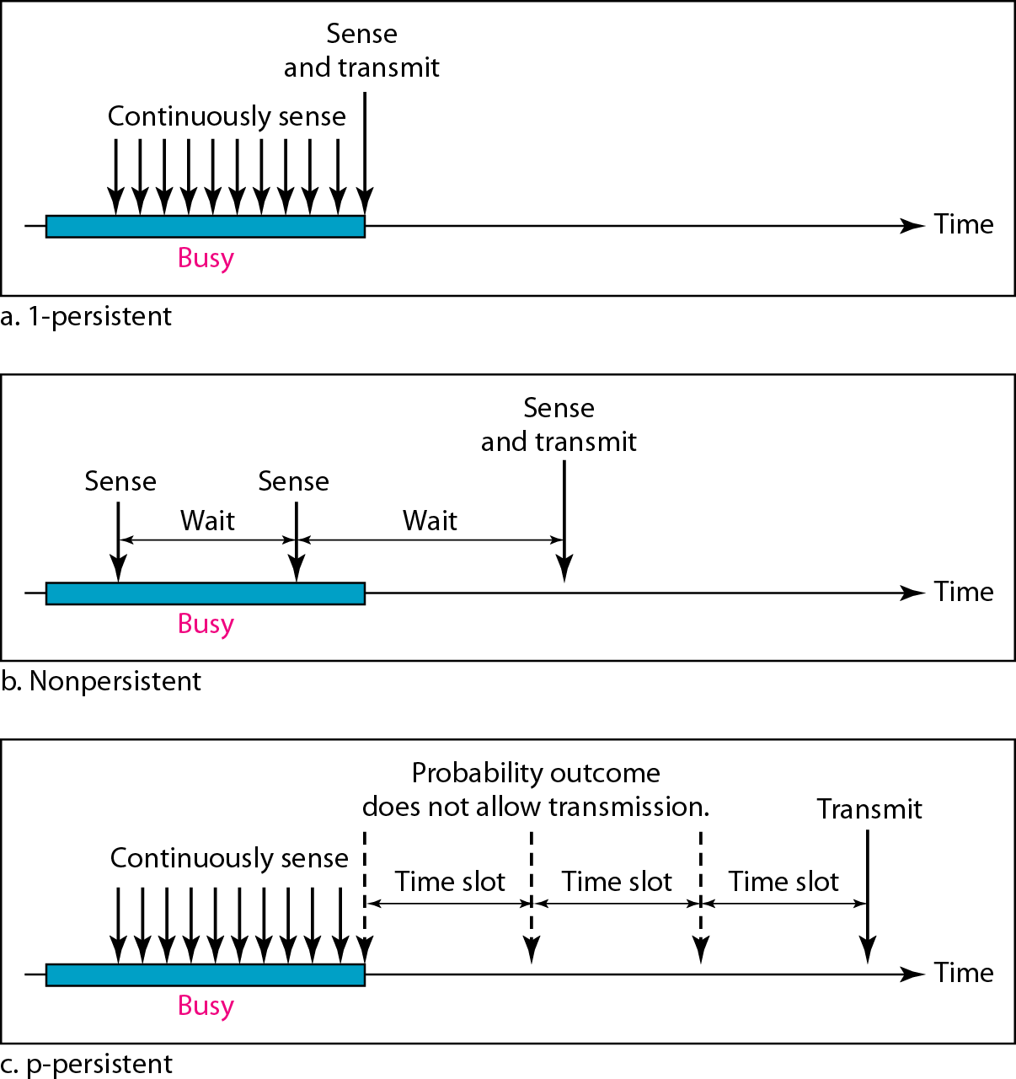
Behavior of three persistence methods

Slide 46
CSMA with Collision Detection (CSMA /CD)
Persistent and non-persistent CSMA protocols improve ALOHA by ensuring that no station begins to transmit when it senses the channel busy.
CSMA/CD (Carrier Sense Multiple Access with Collision Detection) protocol further improves ALOHA by aborting transmissions as soon as a collision is detected.
The conceptual model:
To send data, a station first listens to the channel to see if anyone
else is transmitting.
If so, the station waits until the end of the transmission (1- persistent) or wait a random period of time and repeats the algorithm (non-persistent). Otherwise, it transmits a frame.
If a collision occurs, the station will detect the collision, abort its transmission, waits a random amount of time, and starts all over again.

Slide 47
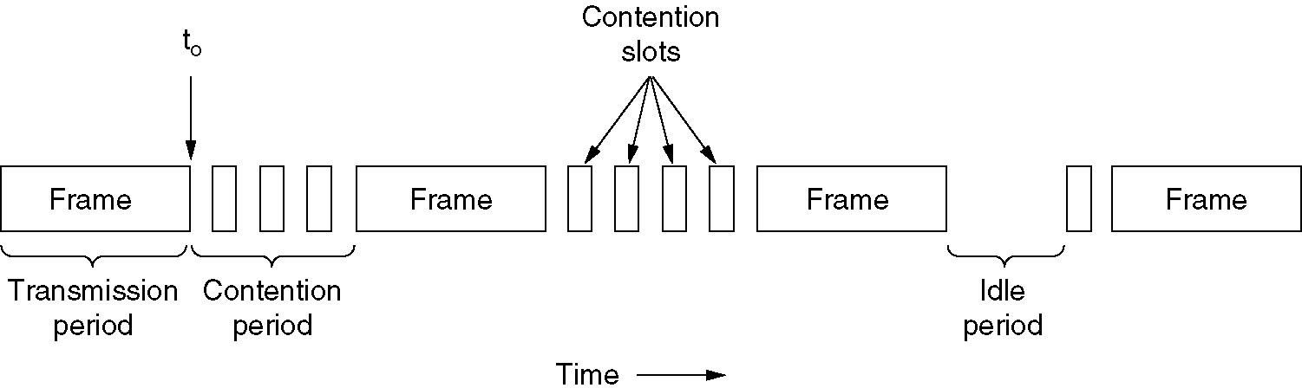
CSMA/CD can be in one of three states:
contention, transmission, or idle
When two stations both begin transmitting at exactly the same time, how long will it take them to realize that there has been a collision ?
The minimum time to detect the collision is the time it takes the signal to propagate from one station to the other.
How long could the transmitting station be sure it has seized the network ?
It is worth noting that no MAC-sublayer protocol guarantees reliable delivery. Even in the absence of collisions, the receiver may not have copied the frame correctly due to various reasons (e.g., lack of buffer space or a missed interrupt).

Slide 48
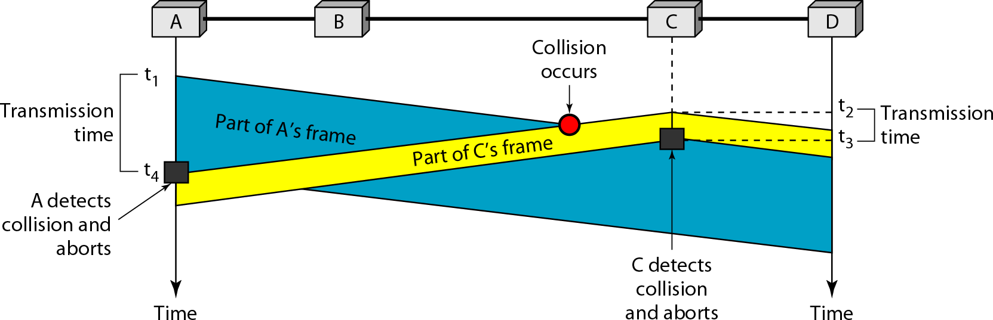
Collision and abortion in CSMA/CD

Slide 49
Question
A network using CSMA/CD has a bandwidth of 10 Mbps. If the maximum propagation time (including the delays in the devices and ignoring the time needed to send a jamming signal, as we see later) is 25.6 μs, what is the minimum size of the frame?
Solution
The frame transmission time is T_{fr} = 2 × Tp = 51.2 μs.
This means, in the worst case, a station needs to transmit for a period of 51.2 μs to detect the collision.
The minimum size of the frame is 10 Mbps × 51.2 μs = 512 bits or 64 bytes. This is actually the minimum size of the frame for Standard Ethernet.

Slide 50
Binary exponential back off
random waiting period but consecutive collisions increase the
mean waiting time
mean waiting time doubles in the first 10 retransmission attempts
after first collision, waits 0 or 1 slot time (selected at random)
if collided again (second time), waits 0, 1, 2 or 3 slots (at random)
if collided for the i^{th} time, waits 0, 1, …, or 2^{i}-1 slots (at random)
the randomization interval is fixed to 0 … 1023 after 10th collision
station tries a total of 16 times and then gives up if cannot transmit
low delay with small amount of waiting stations
large delay with large amount of waiting stations
one slot time = max. round trip delay ≈ 50 microsecs in 10 Mbps Ethernet (see next slide for details of this value)

Slide 51
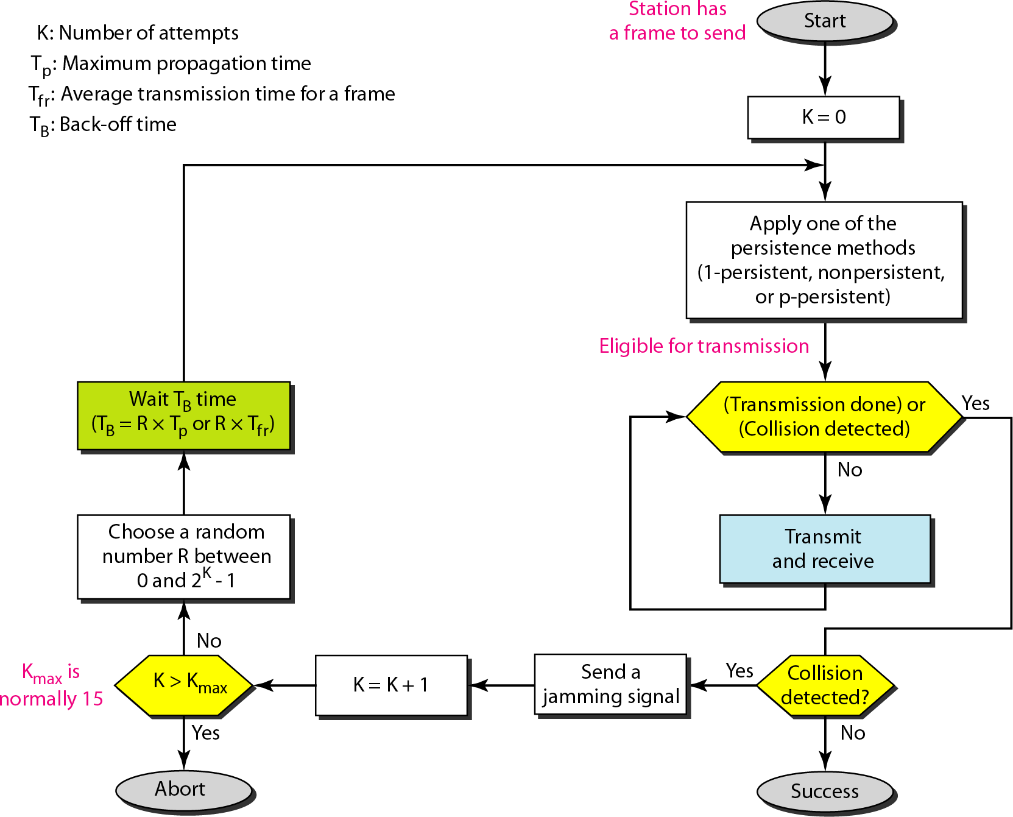
Binaíy exponential back off algoíithm used in CSMA/CD

